Slide 1



APIs have become ubiquitous
Digital transformation
Enablers for the integration of data and business services across platforms
Modern web and mobile development
Growing reliance on third-party services
Emergence of microservices and low-code/no-code platforms
Building blocks for internal reusability and integrated data flow processes.

Slide 2


API proliferation in Modern Enterprise Ecosystems
500
For companies with up to 2,000 people ¹
APIs
10s
For Large enterprise clients ¹
of thousands
API security strategies must evolve to include API protection, Tech Target, 2021

Slide 3














Managing the diverse API landscape adds an additional layer of challenge
Diverse API gateway and management solutions
Azure API Management
MuleSoft
Apigee
Kong
AWS
Diverse API protocols
Async
graphQL
SOAP
REST
Deployments across hybrid and multi-cloud environments
Azure
GCP
AWS

Slide 4

But the Quick Proliferation of APIs triggers API Sprawl
Fragmented API Inventory
Compliance and Security Risks
Reduced Efficiency and Productivity
Poor API Discoverability and Reuse
Not all APIs are visible or managed
Gartner’s 2022 security predictions: By 2025, less than 50% of enterprise APIs will be managed.
Inconsistent API design plus inability to enforce policies consistently
Shadow, Ungoverned APIs low-hanging fruit for attackers
Salt API Security Trends 2023: API attacks increased 400% in the last six months of 2022.
Difficulties in discovering relevant APIs across the organization
Developers may resort to developing duplicate functionalities, contributing further to API sprawl

Slide 5






Untangle Your API Sprawl with Azure API Center!
Centralized API inventory for seamless discovery, consumption, and governance regardless of API type, lifecycle stage, or deployment location.
Create an organizational API center

Slide 6
Azure API Center: Centralized API Inventory for Seamless Discovery, Consumption, and Governance
Centralized API Inventory Management
Streamlined API Governance
Simplified API Discovery and Consumption
Build and maintain an up-to-date inventory of all organizational APIs
Provides visibility into the entire API landscape
Govern org-wide APIs effectively, ensuring compliance with standards and policies
Centralized control over API lifecycle management, security, and compliance.
Easy discovery of APIs within the organization's inventory
Accelerates API consumption

Slide 7

Azure API Center Workshop
API Producers
API Platform Admins
This flash workshop gives you a comprehensive understanding of how to enhance the API management and governance strategies in your organization.
API Consumers

Slide 8
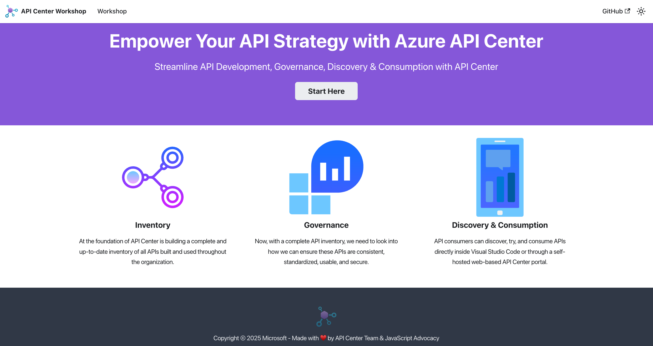
aka.ms/APICenter/Workshop

Slide 9




Platform and API teams collaborate in healthy API ecosystems
API
Minimize friction in producing and consuming APIs
Design, develop, and evolve APIs
Platform team
API teams
Configure and manage API platform infrastructure
Ecosystem
Oversee API inventory, audit and enforce API compliance, monitor traffic, observe platform usage
Publish and maintain production-grade APIs
Notes:
Intro of the different personas

Slide 10
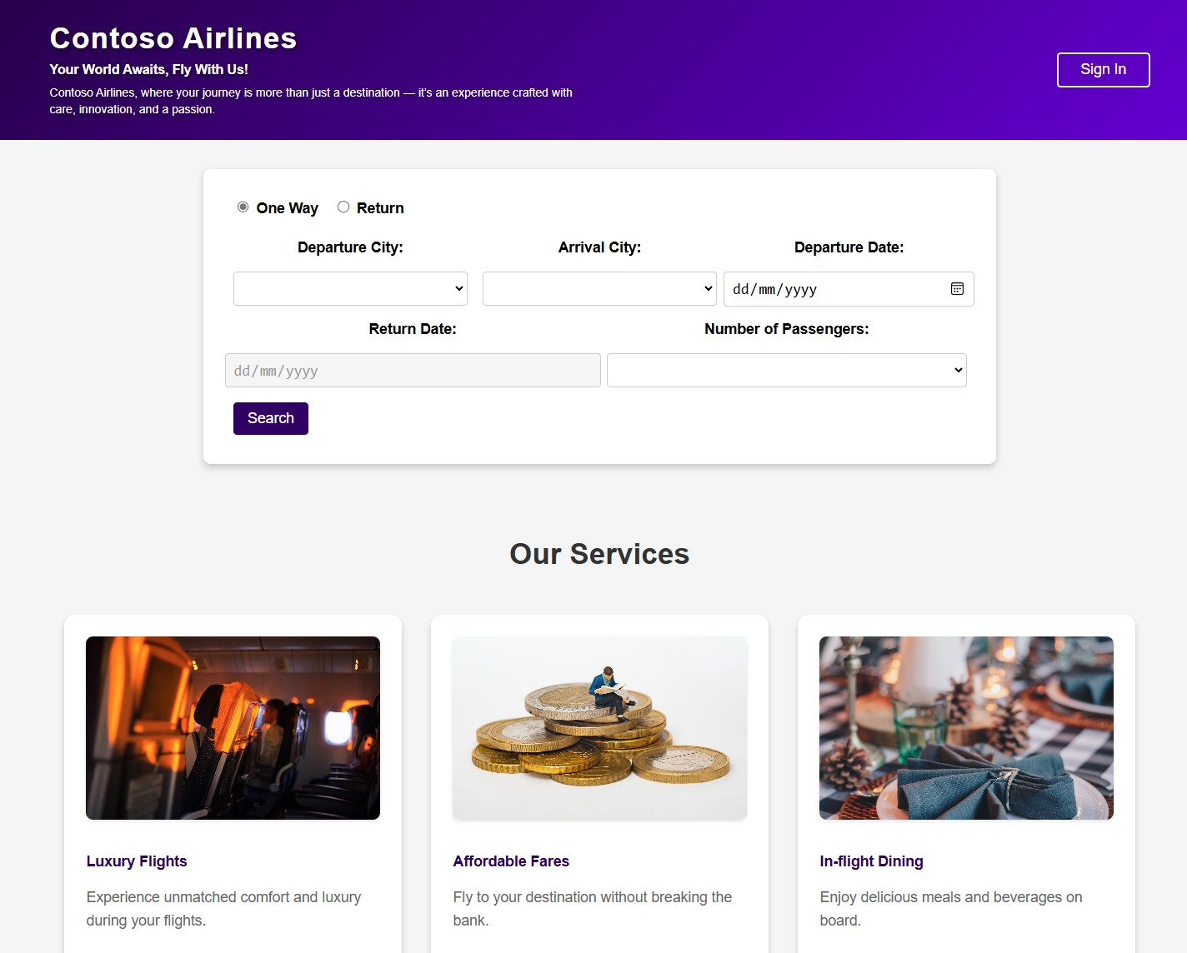
Scenario: Contoso Airlines
Contoso Airlines is a fictitious company that allows users to view available flights, select a pet travel companion, and place an order to adopt a pet post-flight.
User Roles
1. API Producers
Team A: Designs, builds and manages the Services API.
Team B: Designs, builds and manages the Flights API.
Team C: Designs, builds and manages the Pets Travel Companions and Adoption APIs.
2. API Platform Engineer/ Admin
Manages all underlying API infrastructure, enforcing organizational compliance & API design standard policies across all teams.
API Consumers (App Developers)
The core engineering team at Contoso Airlines responsible for building the company website.

Slide 11

“Independently managed developer teams at Contoso Airlines who collect API requirements, research on the existing APIs and design and build APIs.”
“API Admins at Contoso Airlines who provide the underlying infrastructure for building and deploying APIs and manage ALL organizational APIs from different teams.”
“Internal and external developers discovering and testing APIs from Contoso Airlines and building apps using these APIs.”
– API Producers
– API Platform Engineers/ Admins
– API Consumers (App Developers)

Slide 12









Contoso Airlines Architecture
API Consumers
(App developers)
API producers
API Platform Eng. / Admins
API producers
Design and develop
Contoso Airlines
Website
VS Code
VS Code
API Center
Extension
CLI
VS Code
API Center Portal (Azure)
Custom portal
Discover and consume
Push
API Center
Organize and manage inventory at scale
Implement, monitor, and enforce design-time compliance
Monitor non-design-time compliance (e.g., security, privacy)
APIs, versions, deployments
API definitions
Custom Metadata
Populate
CLI
Docker
GitHub
API Platform Eng. / Admins
Populate
Unmanaged APIs
Implement runtime governance
PetTravelCompanion API
(REST)
Flights API
(GRAPHQL)
Services API
(REST)
Deploy

Slide 13


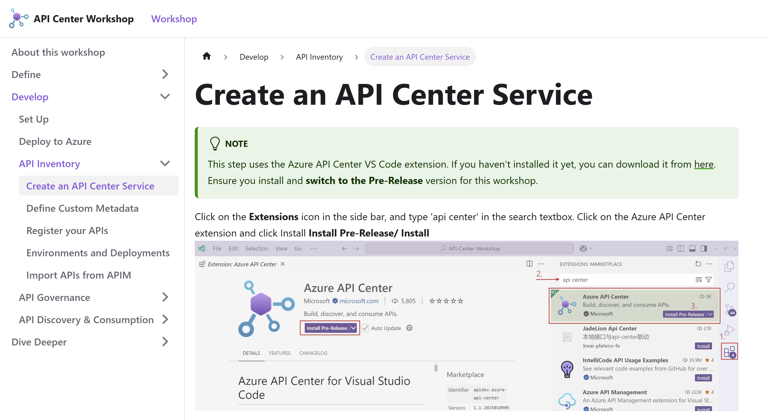
Inventory
You will:
Create an Azure API Center resource
Define organization’s custom metadata
Build your API Inventory
Import APIs from API Management into your inventory
Create Environments and Deployments
aka.ms/APICenter/Workshop

Slide 14

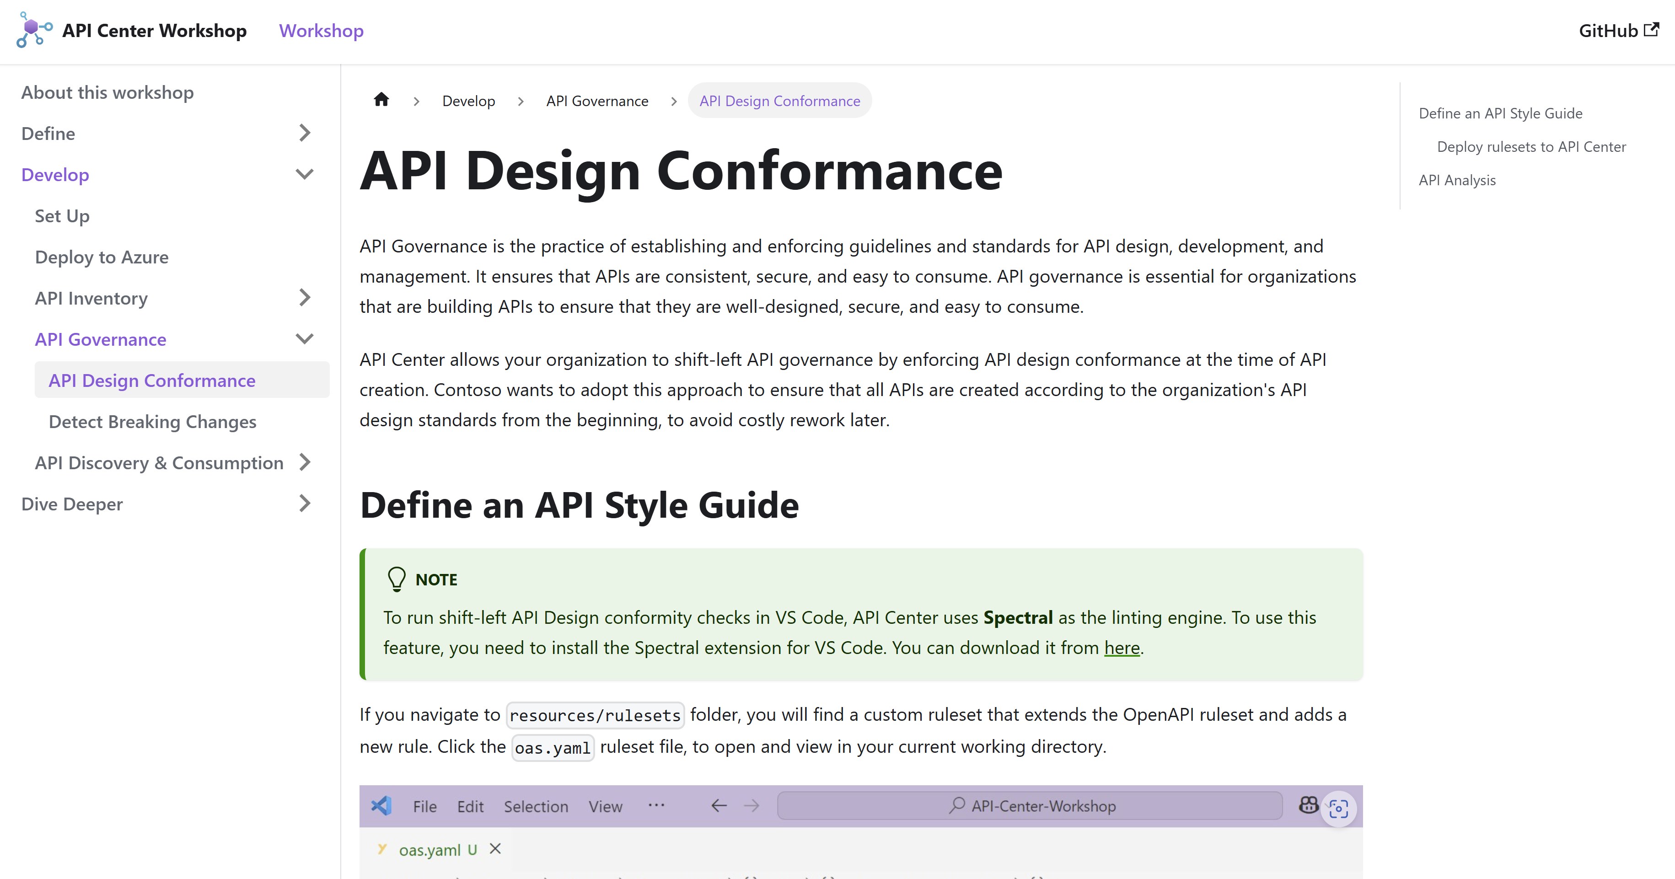
Governance
You will:
Define a custom API Style ruleset
Implement API design conformance checks
Run an API Analysis for APIs within the organization
Detect API versions with breaking changes pre-deployment
aka.ms/APICenter/Workshop

Slide 15

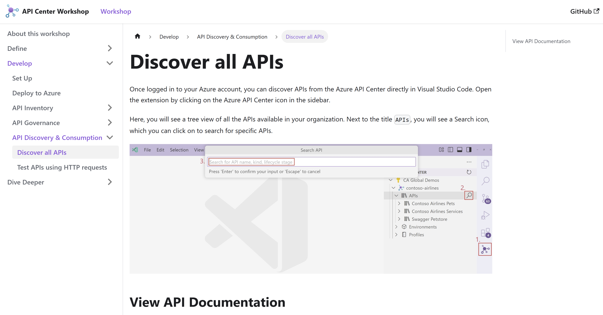
Discovery & Consumption
You will:
Discover all organization APIs
View API Documentation
Perform filtering and sorting based on built-in and custom properties
Test APIs directly using HTTP requests
Generate client SDKs for your organization APIs
aka.ms/APICenter/Workshop

